Slide 1
Lab Equipment
7th Grade Science

Slide 2
Accurately Measures liquids
Graduated Cylinder

Slide 3
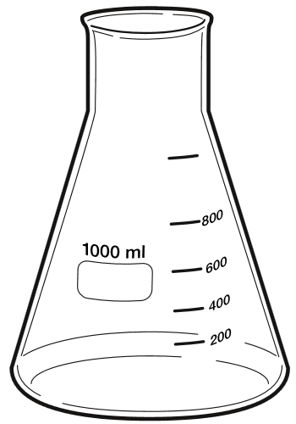
Used to heat, mix, and store liquids
Erlenmeyer Flask

Slide 4
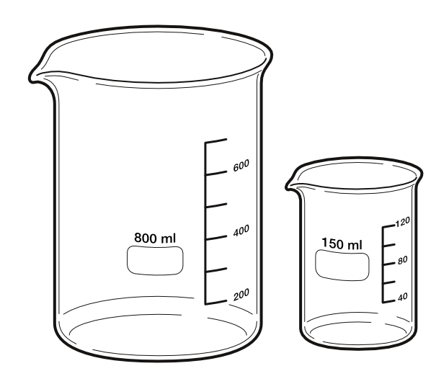
Used to hold liquids and estimate of liquid volume
Beaker

Slide 5
Helps pour liquids into small openings without spilling
Funnel

Slide 6
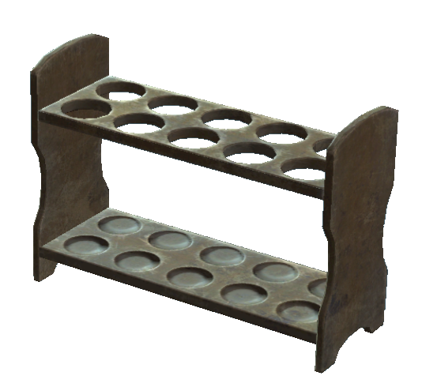
Holds Test Tubes
Test Tube Rack

Slide 7
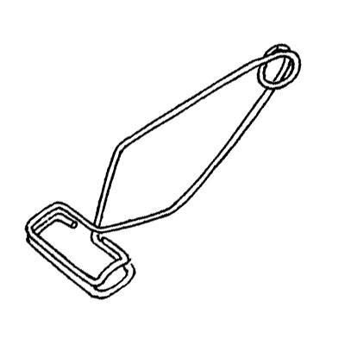
Test Tube Holder

Slide 8
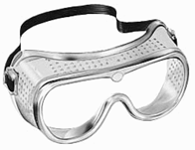
Safety Goggles

Slide 9
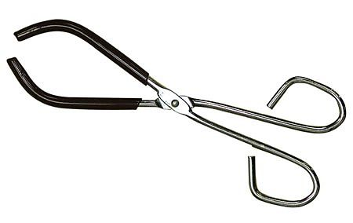
Used to handle a hot beaker
Beaker Tongs

Slide 10
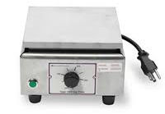
Hot Plate

Slide 11
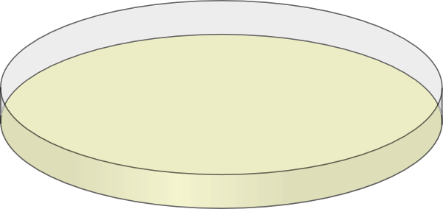
Use to hold specimens and grow bacteria
Petri Dish

Slide 12
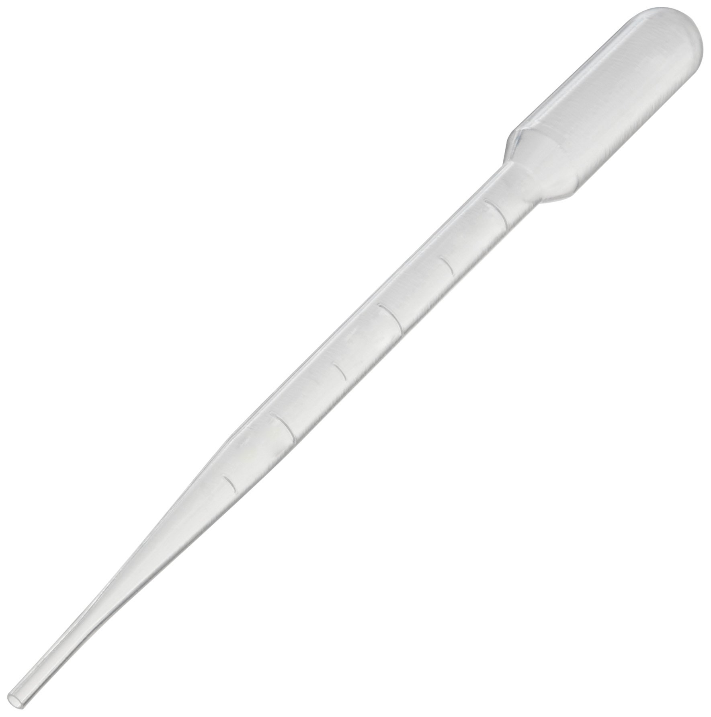
Accurately dispense small liquids
Pipet

Slide 13
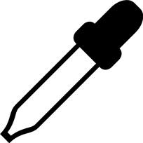
Used to transfer small amounts of liquids, one drop at a time.
Eye Dropper

Slide 14
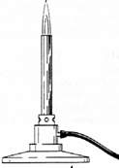
Bunsen Burner

Slide 15
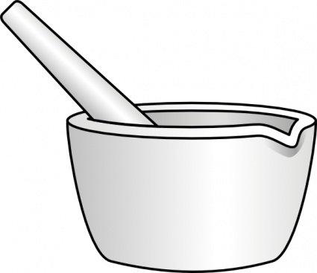
Used to grind solids into a fine powder.
Mortar & Pestle

Slide 16
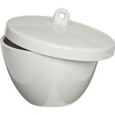
Used for heating certain solids
Crucible

Slide 17
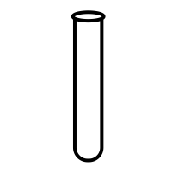
Used to mix and heat chemicals
Test Tube

Slide 18
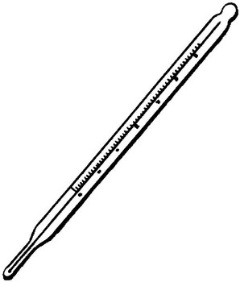
Thermometer

Slide 19
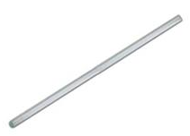
Used to stir solutions
Stirring Rod

Slide 20
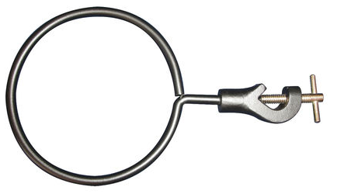
Clamps onto ring stand to sit a beaker
Metal Ring Clamp

Slide 21
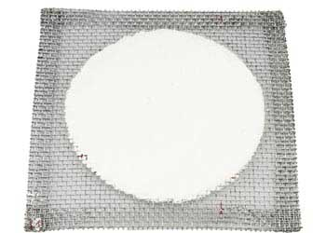
Sits on metal ring stand to provide a place to stand a beaker
Wire Gauze

Slide 22
Ring stand

