Slide 1
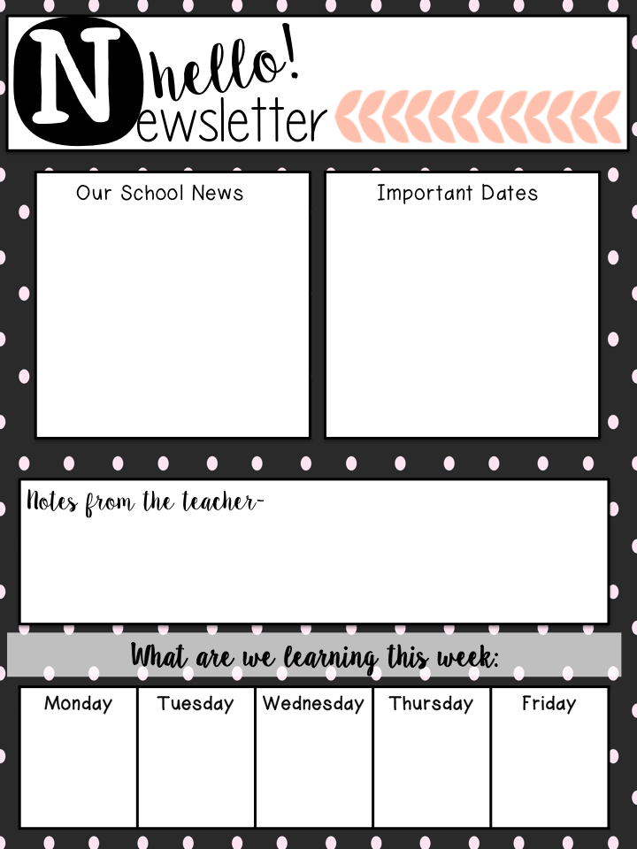
Mrs. Finke’s
Fridge News
Week of October 15-19
October 16th – Robin Hood Play
October 19th- Field Trip
October 26th- No school
October 31st – Halloween Party
Chapter 3 Test-Multiplication & Division-Tuesday, October 17th
*Please turn in ALL permission slips for the field trips next week!
*Please practice multiplication basic facts nightly!
*Please Note: Due to unforeseen circumstances and/or problems with retention of information by students, the following plans MAY change. Please refer to student’s agenda/tracker.
-Review for Chapter 3 Test
H.W.-Study!
-Review for Chapter 3 Test
H.W. Study!
Robin Hood Play at the High School!
Chapter 3 Math Test
-Begin Chapter 4 Lessons 1 & 2
H.W.-None
Fourth Grade Field Trip!

