Slide 1
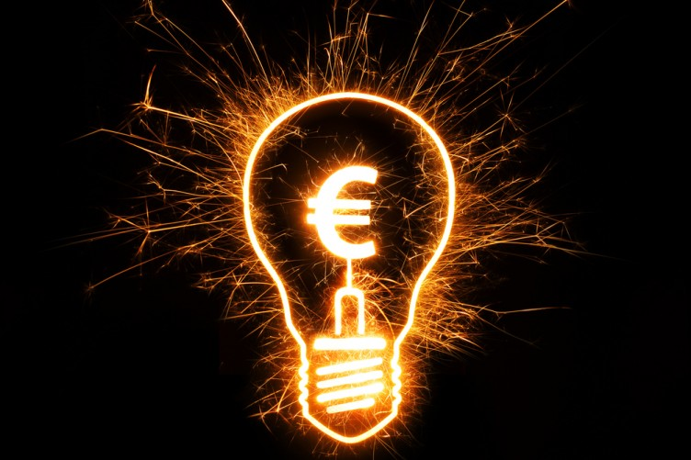
Electricity
Static Electricity: Part 1

Slide 2
What are electric charges?
All matter is made of ________________
Atoms are made of 3 subatomic particles
___________________ = positive charges in the nucleus
___________________ = neutral charges in the nucleus
___________________ = negative charges spinning around the nucleus
atoms
Protons
Neutrons
Electrons

Slide 3
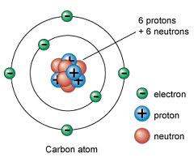
What are electric charges?
Electrons
Protons
Neutrons

Slide 4
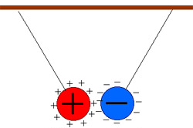
What are electric charges?
Although electrons spin very quickly they don’t fly off
The protons hold them in place
Positive charges are __________ to negative charges
attracted

Slide 5
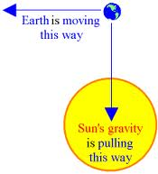
What are electric charges?
Similar to the sun and the earth
Earth spins around the sun very quickly
We don’t fly off into space because the sun’s gravity pulls us in
The sun = _________________ and
the earth = ________________
protons
electrons

Slide 6
What is an electric force?
Electricity = the interaction between electric charges
Electric force = the specific type of interaction between charges
___________ = when charges move toward one another.
__________ = when charges move away from one another
Attract
Repel

Slide 8
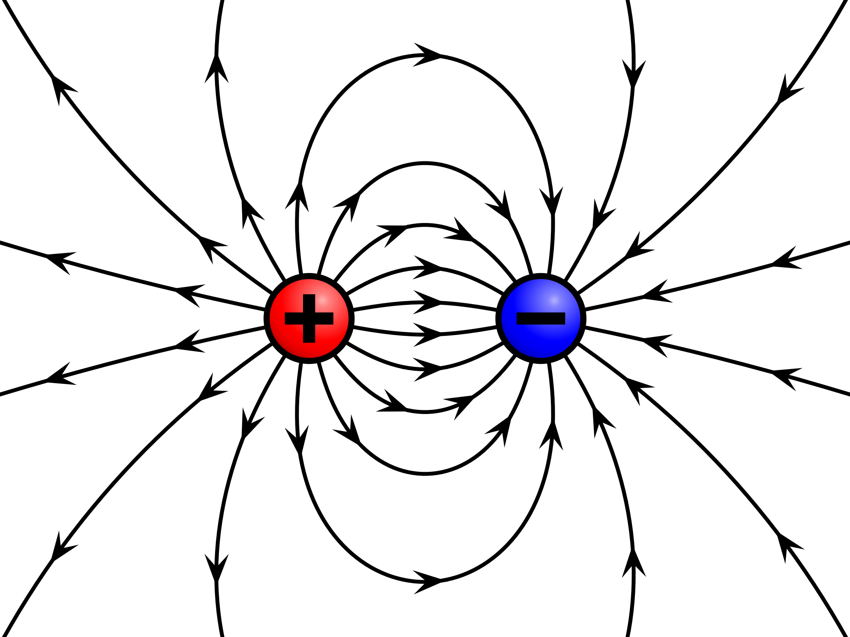
What is an electric force?
The type of electric force depends on the electric __________ surrounding each charge involved.
An invisible region surrounding a charge in which it exerts its electric force
When another charge enters this field, it is either attracted by or repelled by the first charge
field

Slide 9
DRAW THE CHARGE & ELECTRIC FIELD!
Single protons:

Slide 10
DRAW THE CHARGE & ELECTRIC FIELD!
Single electrons:

Slide 11
DRAW THE CHARGE & ELECTRIC FIELD!
Two protons:
Repel

Slide 12
DRAW THE CHARGE & ELECTRIC FIELD!
Two electrons:
Repel

Slide 13
DRAW THE CHARGE & ELECTRIC FIELD!
A proton and an electron:
Attract

Slide 14
What is an electric force?
Combination of Charges | Type of force created
Proton and Proton
Electron and Electron
Proton and Electron
Repel
Repel
Attract
*Opposites Attract*

Slide 15
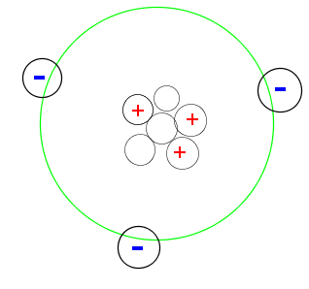
What is static electricity?
Under normal conditions:
Atoms have _______ numbers of protons and electrons
Atoms are electrically ________________
Objects made of neutral are also electrically neutral
Neutral objects _____________ experience electric forces.
Equal
neutral
do not

Slide 16
What is an electric force?
We can change the electric charge of objects
Atoms hold their protons _____________
Atoms hold their electrons ____________
tightly
loosely

Slide 17
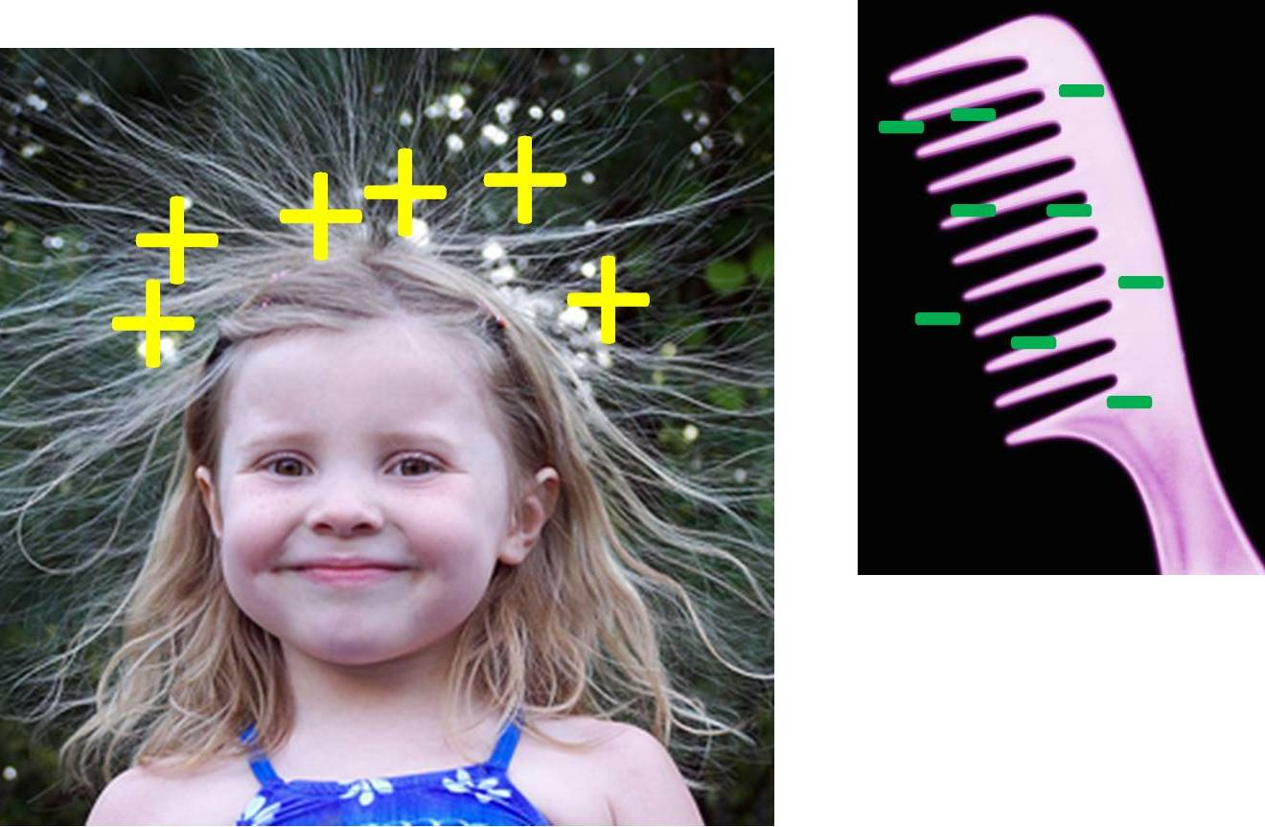
What is an electric force?
When objects slide past one another or come in contact, electrons can transfer between them
The object that gains electrons becomes ______
The object that loses electrons becomes ______
They may then exert electric forces.
negative
positive

Slide 18
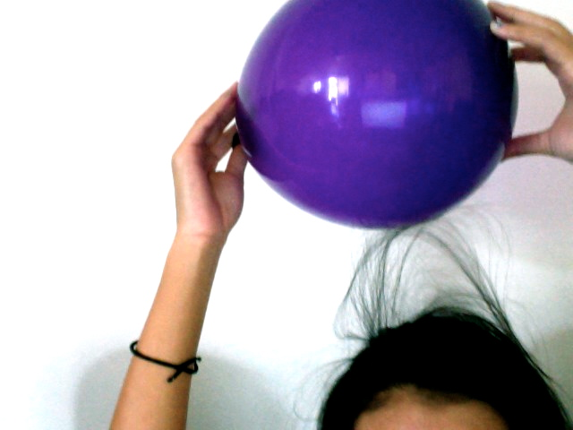
What is an electric force?
This leads to static electricity = a buildup of electrical charges that do not constantly ___
flow

Slide 19
What is an electric force?
Charge is _____ Charge is ______
0
0

Slide 20
What is an electric force?
_____ 4 electrons ______ 4 electrons
Lost
Gained
Charge is now ___ Charge is now ___
+4
-4
attract
They will ___________ one another

Slide 21
Electricity
Static Electricity: Part 2

Slide 22
How do objects become charged?
Charges cannot be created or destroyed
Electrons simply _____________________ from one object to another
One object loses its electrons
One object gains these electrons
transfer
A
B
+
-
+
2e-
-
+
+
-
+
-
-
-
+
-
-
+
+
+
-

Slide 23
How do electrons transfer?
1) _____________________
When two ____________________ objects rub together
The object that loses electrons becomes _______________________
The object that gains electrons become _______________________
Example: Clothes tumbling over one another in the dryer
Friction
uncharged
positive
negative

Slide 24
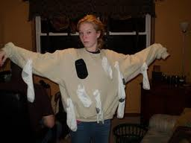
How do electrons transfer?
_____________________
Friction
uncharged
Becoms __
-
Electrons
Friction
uncharged
Becomes __
+

Slide 25
How do electrons transfer?
_____________________
When a charged object ____________________ an uncharged object
Electrons flow from negatively charged object to the uncharged object.
Example: Touching a Van de Graff generator
Conduction
touches

Slide 26
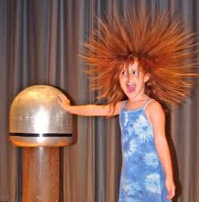
How do electrons transfer?
_____________________
Conduction
uncharged
Becomes __
-
Electrons
Negative
Friction
Becomes__
+

Slide 27
How do electrons transfer?
_____________________
When a charged object is brought near an uncharged object without ____________________ it
If the charged object is positive, it attracts the _____ electrons of the uncharged object
If the charge is negative, it attracts the ___ protons of the uncharged object
Example: Getting shocked by a doorknob without touching it.
Induction
touching
-
+

Slide 28
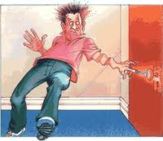
How do electrons transfer?
_____________________
Induction
+
+
-
+
+
+
-
+
Positive Charge
Uncharged
+
+
-
+
+
+
-
+
-
-
+
-
-
-
+
-
Negative Charge
Uncharged
-
-
+
-
-
-
+
-

