Slide 1
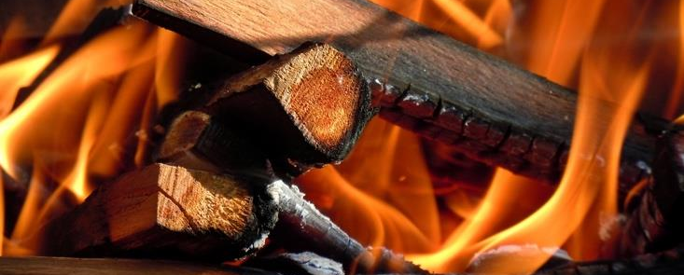
CHAPTER 2: CHEMICAL REACTIONS
2-1:OBSERVING CHEMICAL CHANGE

Slide 2
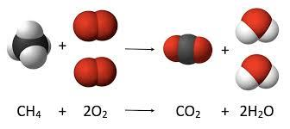
CHEMICAL REACTION
Occurs when two or more molecules interact and the molecules change into a new substance.
Bonds between atoms are broken and created to form new molecules

Slide 3
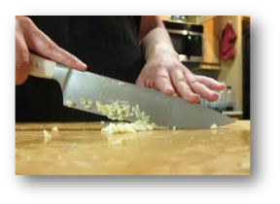
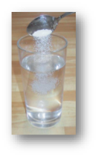
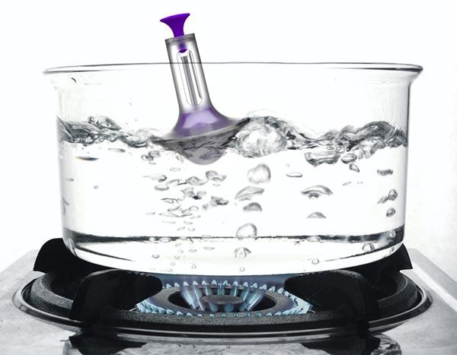
PHYSICAL CHANGES
•Changes the form or appearance of a substance.
•Does not change substance into anything new.
Examples •Boiling water •Dissolving sugar •Dicing vegetables

Slide 4
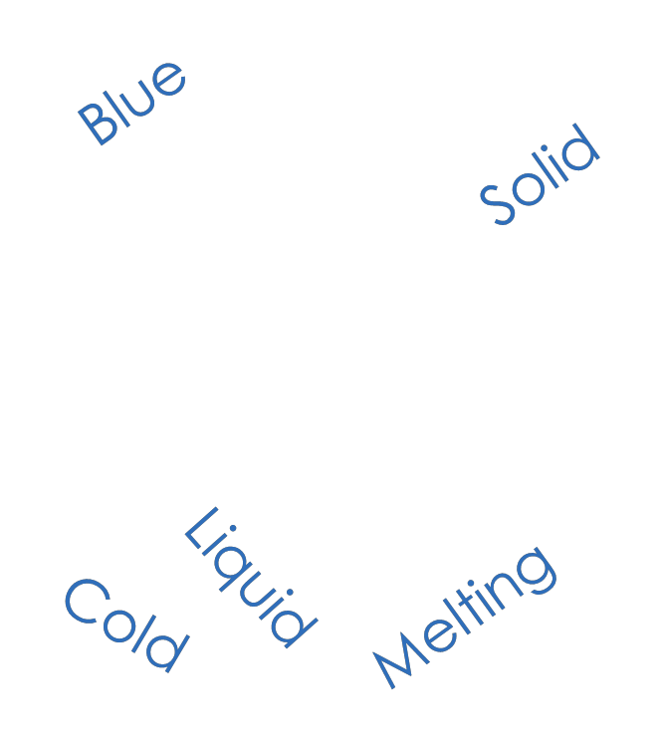
TYPES OF PHYSICAL CHANGES
Changing the state of matter
Changing the shape
Changing the texture

Slide 5
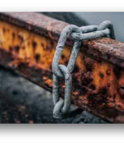
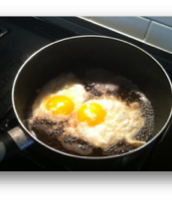
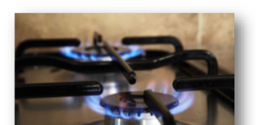
CHEMICAL CHANGE
• When two or more substances join to form new substances with new chemical properties.
Examples •Iron rusting •Gas burning •Eggs cooking

Slide 6
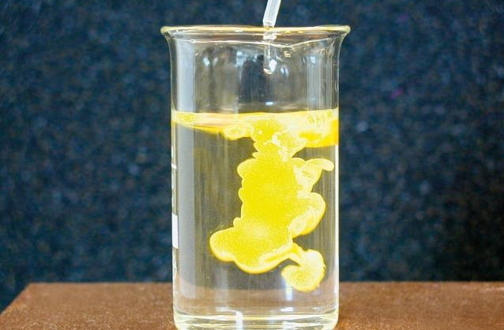
EVIDENCE OF A CHEMICAL CHANGE
1) Unexpected Color Change
New molecules created in a chemical reaction radiate light differently producing new colors.
Examples: • Fireworks •Leaves a change color

Slide 7
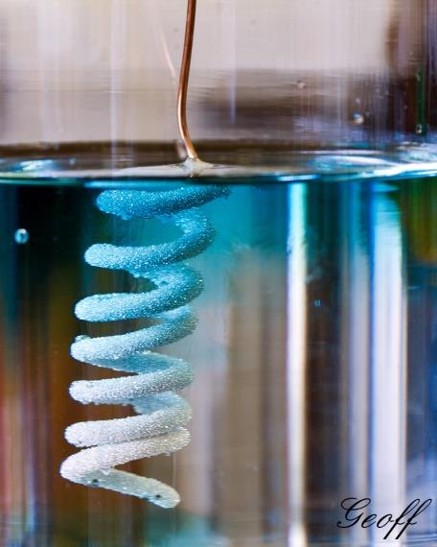
EVIDENCE OF A CHEMICAL CHANGE
2) Precipitates Form
When a solid suddenly appears in a solution and settles to the bottom, collects on another object, or makes the solution cloudy.
Examples:
•Milk souring •Bathtub rings

Slide 8
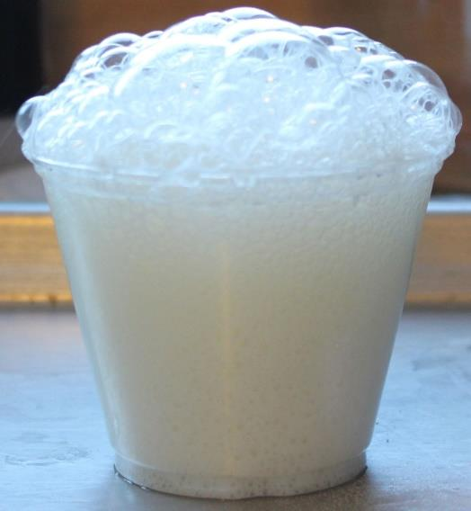
EVIDENCE OF A CHEMICAL CHANGE
3) Bubbles Form
When gases produced in a chemical reaction are released.
Examples: • Alka-Seltzer •Bubbles in sodas

Slide 9
EVIDENCE OF A CHEMICAL CHANGE
4) Change in Energy
During chemical bonding, energy is released (exothermic reaction) or absorbed (endothermic reaction) making their surroundings hotter or cooler.
Examples:
•Adding salt to ice lowers its freezing point.
•Body temperature changes to fight infections.

